Slide 1
Marketing Team
2025

Slide 2
How we can help
Marketing team
Campaign planning
If you are looking for marketing or business development support, we can assist with:
Client communications
Email campaigns
Events & webinars (client and staff)
Website – service pages or guides (such as the Autumn Budget)
Team photography
Corporate sponsorship
General support
The team can help with a variety of tasks, including:
Branding of PowerPoint, Word and Excel documents
Headshots
The Loop posts
Social media training
Website articles and social media posts on Affinia channels

Slide 3
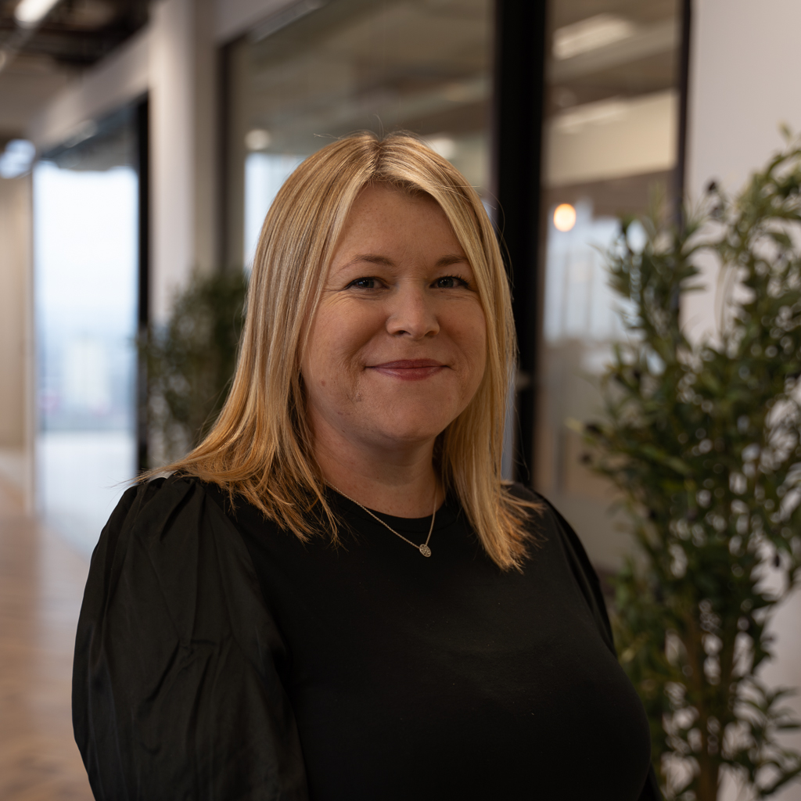
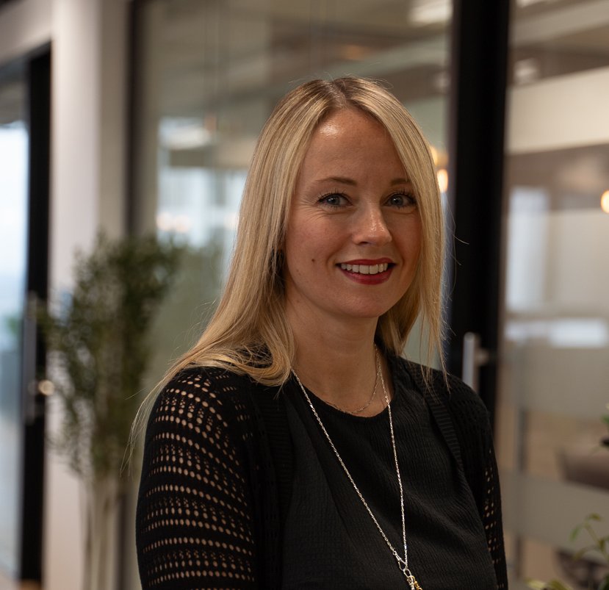
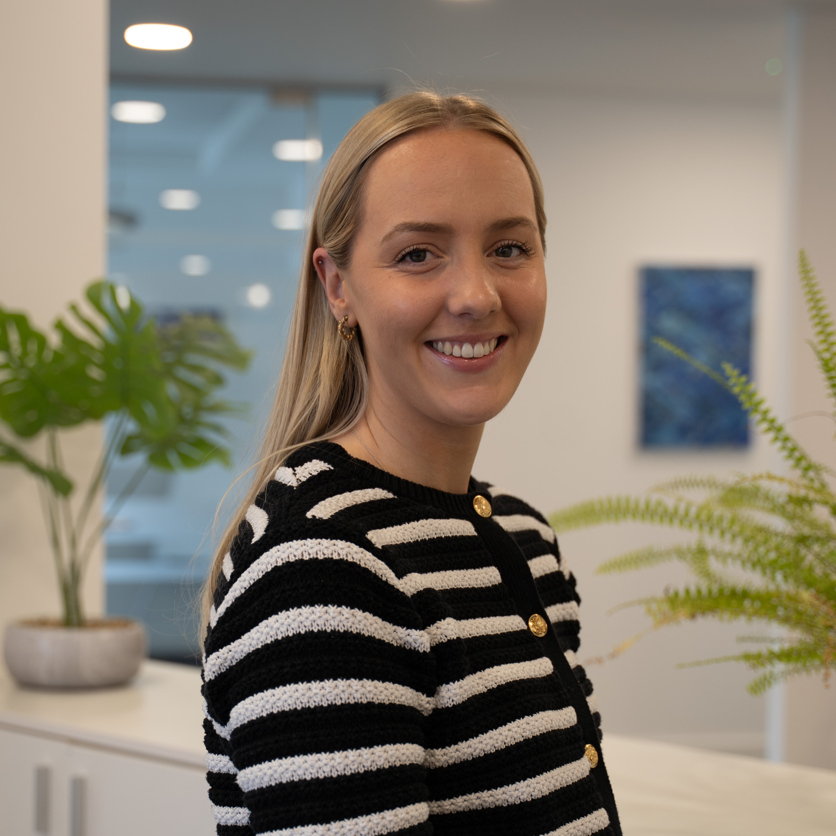
Marketing Team
Meet the team
Nicki Ramsbottom
Head of Marketing
Claire Berg
Marketing Manager
Emily Bickers
Marketing Manager
Find out more about our team members and their specialisms here:
Strategy & planning
Projects
Systems
PR
Integration
Lead for Education and Payroll
Communications
Lead for Stratford, Sidcup, Orpington and Sutton
Lead for CF / M&A and Audit
Digital
Lead for Chelmsford, Colchester, Halstead, Harlow, Ipswich and Leigh-on-Sea
Lead for Accounts (Cloud & Digital) and Private Client Tax

Slide 4
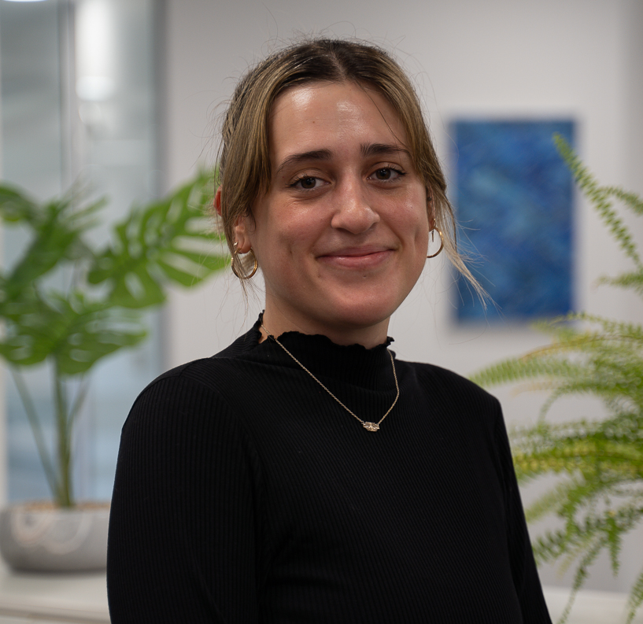
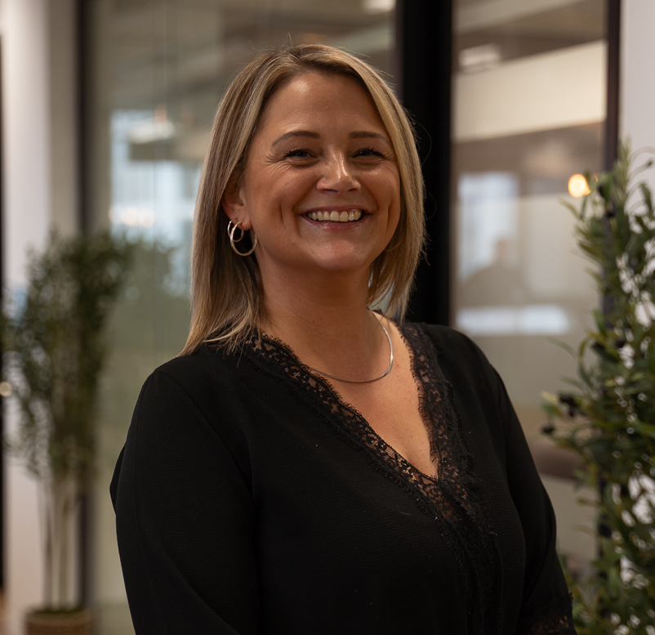
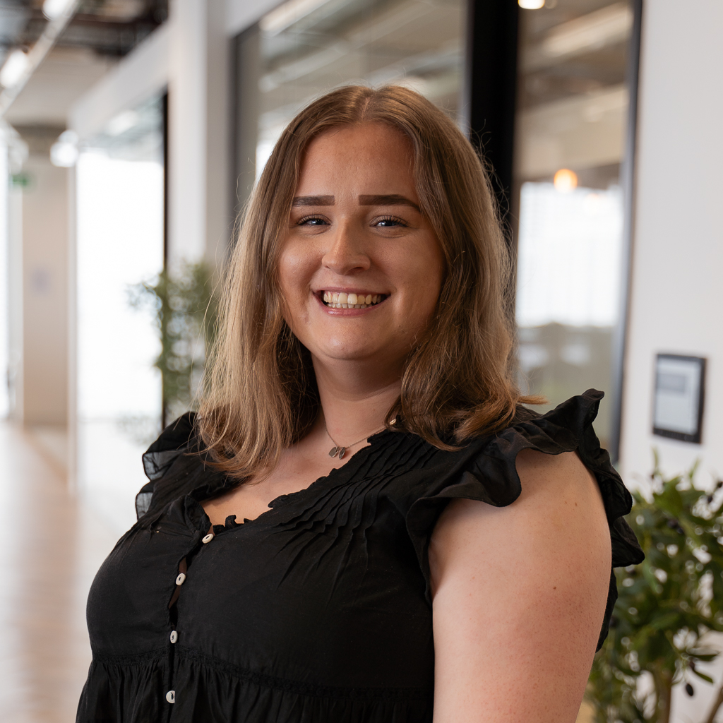
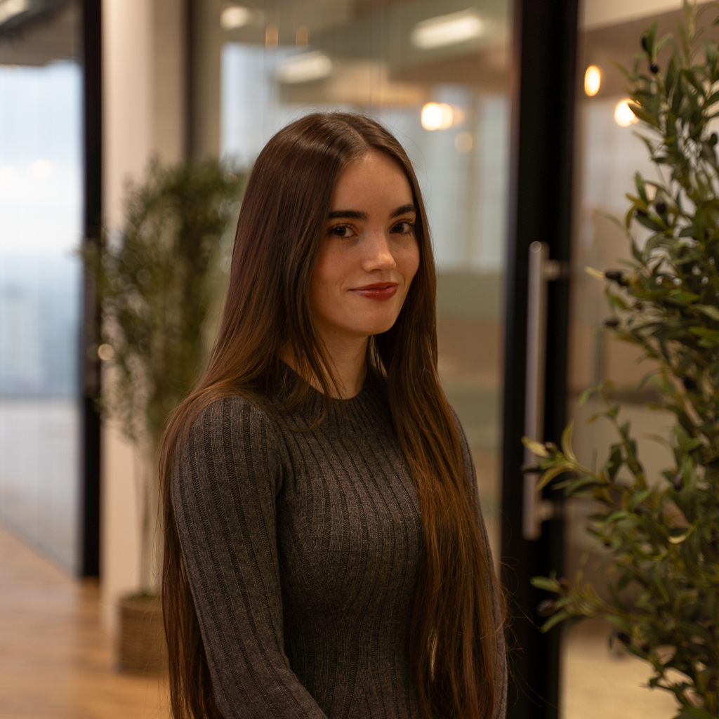
Meet the team
Maddy Pickup
Marketing Executive
Carly Haines
Marketing Executive
Maddie Orrow
Communications Co-ordinator
Jess Johnson
Marketing Assistant
Creative
Brand
Photography & Videography
Lead for Property Tax
Events
Client and staff events
MailChimp campaigns
Data and CRM
Communications and admin support
The Loop
Digital Support
PR Support
Marketing Inbox
Design and admin support
Graphic design
Digital support
Data support

Slide 5
Contact Us
Marketing Team
Looking for brand support?
You can find the below items (and more) via our brand guidelines portal:
Logos
LinkedIn headers
Teams backgrounds
Document templates
Guidance on how to use our brand
If you would like support from the team, please contact us via:
marketing@affinia.co.uk
in the first instance. We will respond within 24 hours to confirm who will support you on your request.
Click here

